Slide 1
How (not) to Write Contest Solutions
Math Club 4/11

Slide 2
This week’s math contests
Euclid: Tuesday 4/12; 10 written questions, 2 hours 30 minutes
Galois/Hypatia: Wednesday 4/13; 4 written questions, 75 minutes

Slide 3
Written solutions?
Yup, you have to write and justify your answer.
A correct solution poorly presented will not earn full marks.
You can get part marks for progress.

Slide 4
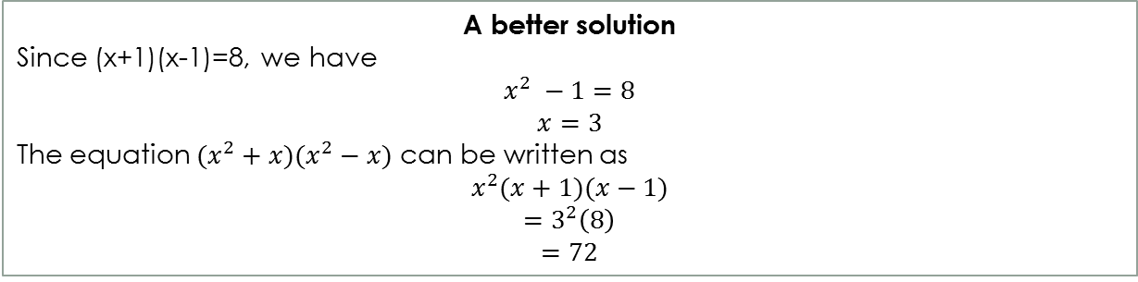
An (easy) sample problem
If (x + 1)(x - 1) = 8, determine the numerical value of (x² + x)(x² - x). (Euclid 2010 2c)
Solve the problem first before writing.
Justify your answers.
A bad solution
The answer is 72.
A better solution
Since (x+1)(x-1)=8, we have
$$x^{2} −1=8$$
$$x=3$$
The equation $(x^{2}+x)(x^{2}−x)$ can be written as
$$x^{2}(x+1)(x−1)$$
$$=3^{2}\left(8\right)$$
$$=72$$

Slide 5
How much is enough?
It’s generally better to write more.
If a theorem has a name, you can cite it (eg. Pythagorean theorem, Law of Sines, Heron’s Formula)
If the theorem doesn’t have a name, try to prove it in one or two lines. If you can’t say ‘according to a well known theorem…’
“Paper is cheap. I use it to wipe my butt every day” – Linus Torvalds
Don’t be afraid to use extra paper.

Slide 6
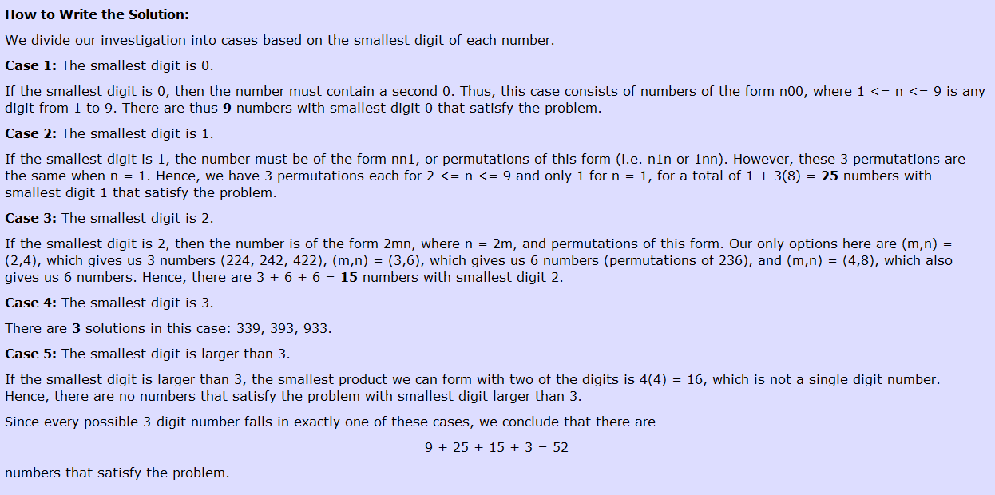
Be clear
Name your stuff (instead of saying ‘the sum of the sequence’, call the sum S)
Be very specific (instead of ‘for any x’, write ‘for any integer x>1’)
Use lemmas (sub-proofs) to prove the main problem.
When using cases, make the cases clear:

Slide 7
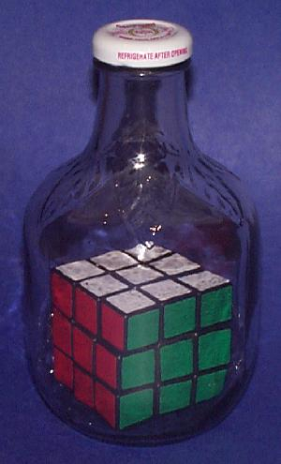
Think backwards, Write forwards
Problem: How did I put a rubik’s cube in a bottle?
The reader doesn’t care how you derived the solution.
A bad solution
The cube couldn’t have been put in through the neck of the bottle because it’s too small. You can’t stretch glass to put it in either. But you can disassemble a rubik’s cube into small pieces, and reassemble it back together. Each of the small pieces can fit in through the neck. You can reassemble the pieces back together in the bottle (using tweezers). QED.

Slide 8
Geometry problems
It’s very helpful to have a ruler and a compass.
Drawing accurate diagrams help you notice relationships you wouldn’t otherwise notice.
It also helps to use colored pencils to mark sides / angles (just don’t use refer to ‘the red line’ because graders get photocopied papers)

Slide 9
Math grammar
Try to use proper english grammar / spelling / punctuation.
It’s okay to use “we” in a proof; “we” refers to the author and the reader or the lecturer and the audience.
Don’t BS. The papers are marked by university professors. Use your time to check your work or find an actual solution. (except for the COMC, where it’s marked by undergraduates and high school teachers and you should BS as much as possible ;))

Slide 10
Problem type 1
“Prove that…” or “Determine”
The objective is clear, you just have to derive some statement from the given data by a series of logical steps.
It helps to work backwards (it suffices to prove [weaker lemma])
If stuck, you can list everything you know about the problem (constraints, equalities, etc)

Slide 11
Problem type 2
“Find a…” or “Find all…”
Requires you to find something that satisfies a bunch of requirements
Usually involves guessing a solution that nearly works, then tweaking it…
“Find all…” requires you to prove that no other solutions exist, even if you have already found some solutions.

Slide 12
Problem type 3
“Is there a …”
You have to determine if the statement is true or false.
If it’s true, you have to prove it.
If it’s false, you only have to provide a counterexample.

Slide 13
Good luck tomorrow! :D

